Slide 1
Wi-Fi:
Starspace 46 guest
Password:
Techlahoma

Slide 2
FreeCodeCampOKC.com
facebook.com/groups/free.code.camp.oklahoma.city
linkedin.com/groups/12086660
meetup.com/FreeCodeCampOKC
twitter.com/FreeCodeCampOKC

Slide 3
Thanks for joining us today! We're here thanks to volunteers, speakers, and Techlahoma.

Slide 4
What is Techlahoma?
non-profit volunteer-run organization
hosts 33 groups and 2 conferences
sponsors free local events
supports the grassroots tech community of Oklahoma

Slide 5
Techlahoma.org
meetup.com/pro/Techlahoma
twitter.com/Techlahoma
donate.techlahoma.org/membership

Slide 6
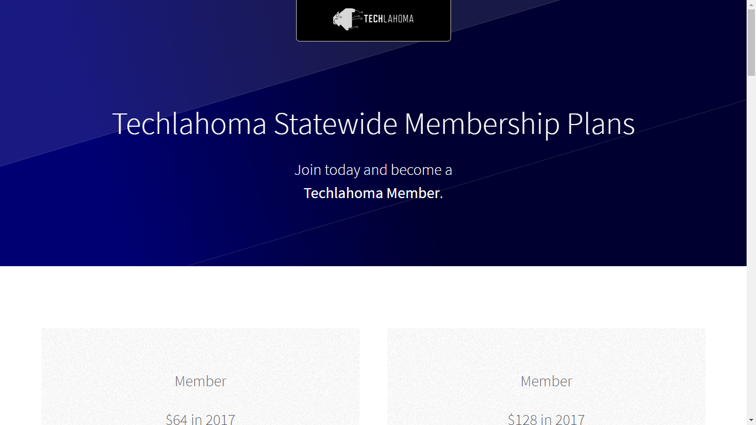
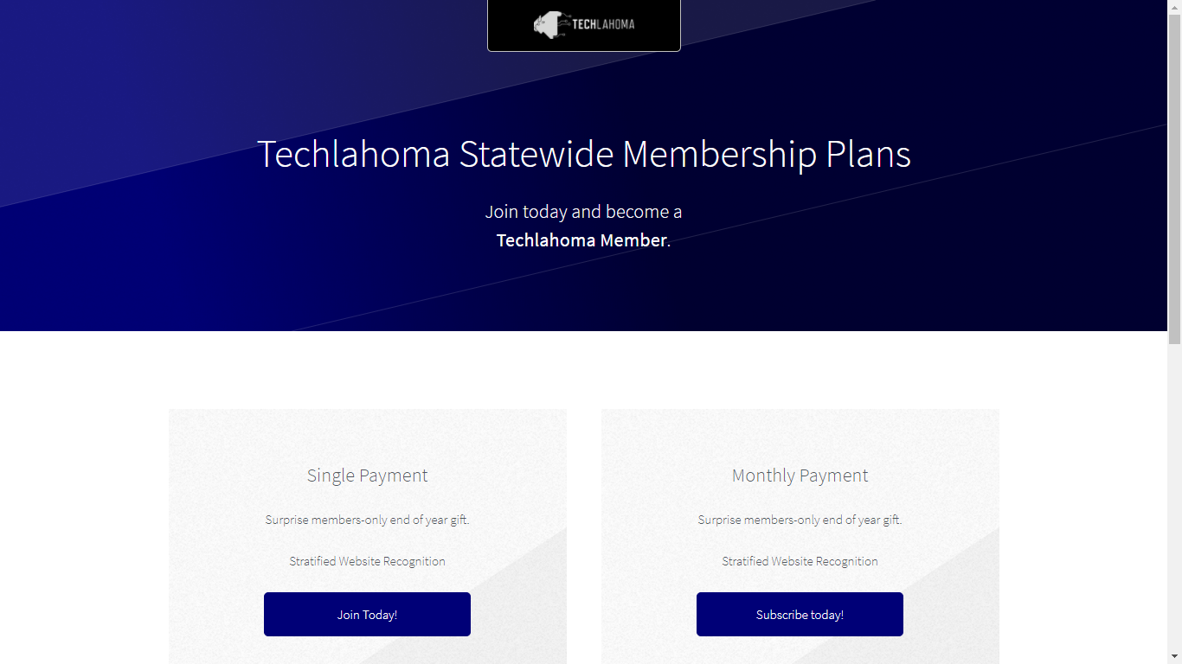

Slide 7
StarSpace46.com
starspace46.com/calendar-1
twitter.com/StarSpace46
Community membership $40/month

Slide 8
Twitch.tv/Techlahoma
Live streaming at StarSpace46
Subscribe with Amazon Prime
Techlahoma gets a small donation from Amazon

Slide 9
Slack
fccokc.com/slack
Channels for #freecodecamp, #jobs, #javascript, #design, and over 150 other topics

Slide 10
OKC Coffee & Code
Next meetup will be scheduled soon!
Contact Kimberly Collins for details
www.meetup.com/okccoffeeandcode

Slide 11
OKC WordPress
Thursday 1/25
11:30 - 1:00
BackupBuddy Demo
www.meetup.com/OKC-WordPress-
Users-Group

Slide 12
Code Norman
Saturday 1/27
2:00 - 4:00 pm
D3 - Data-Driven Documents
www.meetup.com/code-norman

Slide 13
Free Code Camp OKC
Sunday 1/28
1:00 - 2:00 pm
Getting Started on a Project
www.meetup.com/freecodecampokc

Slide 14
SheCodes OKC
Sunday 1/28
2:30 - 4:30 pm
Lightning Talks
www.meetup.com/shecodesokc

